Slide 1



Passive Respiration Detection via mmWave Communication Signal Under Interference
Kehan Wu, Renqi Chen, Haiyu Wang, Chengqing Ji, Jiayuan Zhu
Supervisor: Rui Wang, Guang Wu
Notes:
Good afternoon, everyone. My name Kehan Wu from Sustech. My supervisor is Rui Wang.

Slide 2
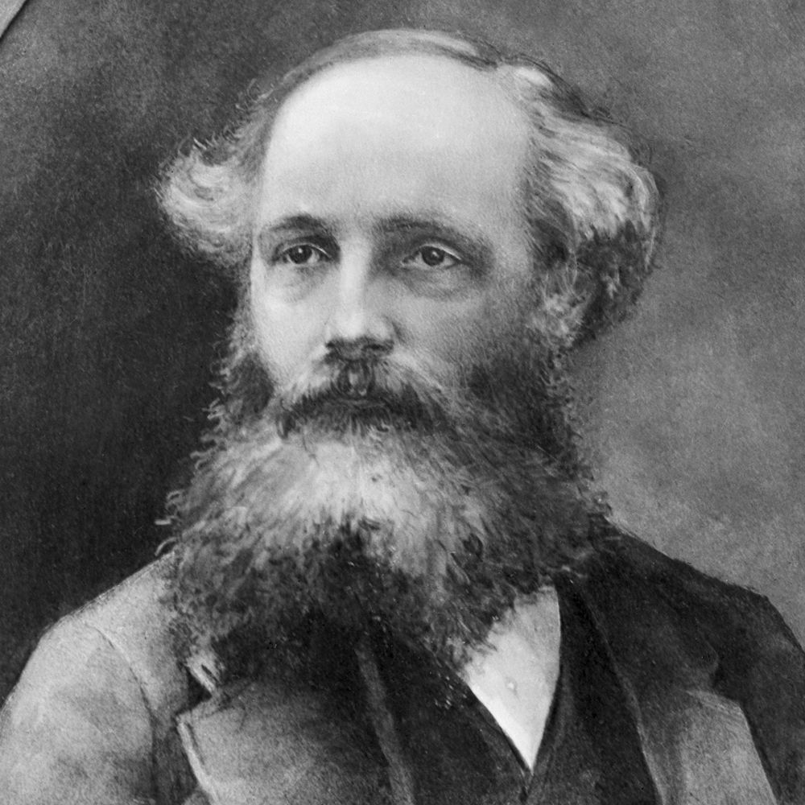
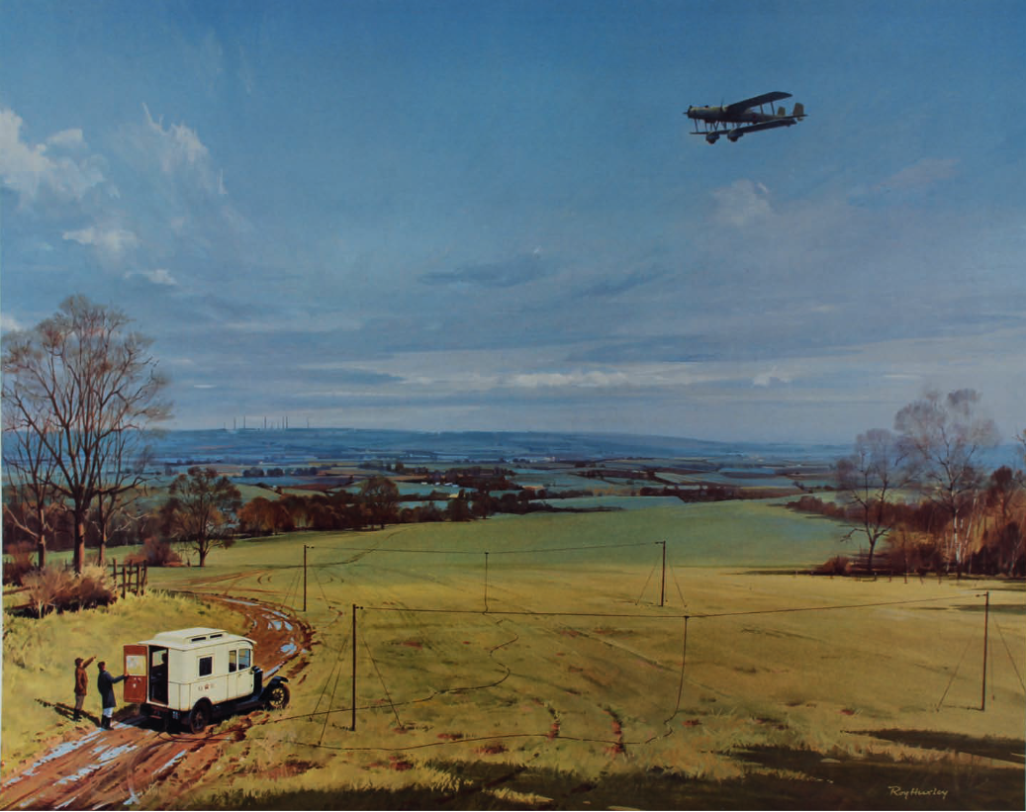
01.Intro & Background
Sensing through RF signal remains a long time problem
Notes:
As we know, Maxwell discovered the physical laws of electromagnetic waves 160 years ago. However, it is still very difficult for us to precisely sensing the environment along the propagation of RF signals in an electronically complex and large environment because of the complicated interactions between the RF signals and the obstacles, such as scattering, diffraction, reflection and absorption. In this work, we are trying to take advantage of neural networks to revisit this long-standing problem.

Slide 3
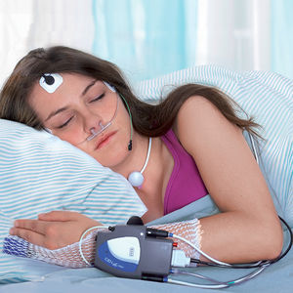
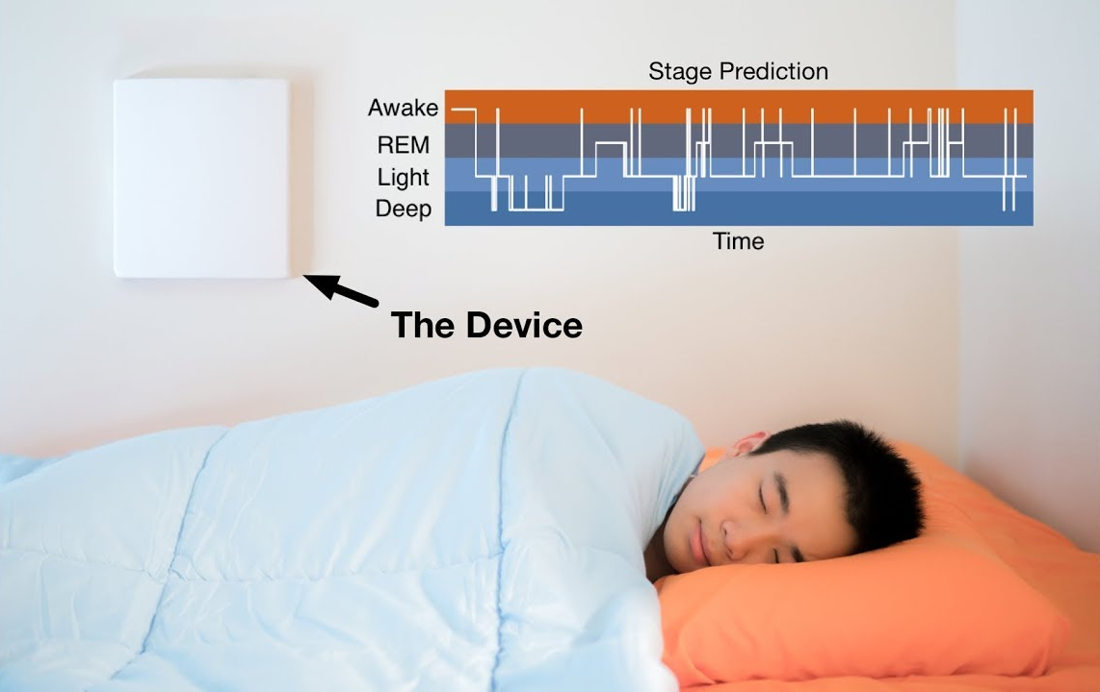
01.Intro & Background
Respiration monitoring is important for health care
Sleep Apnea detection
Sleep stage recognition
Notes:
Accurate monitoring of human respiration plays a crucial role in a wide range of applications, such as sleep stage recognition and sleep apnea detection. Recently, Many approaches have achieved human respiration in good performance, which has been widely used in hospitals or daily life scenes. As shown, It is roughly divided into two types, contact and non-contact monitoring. Lets only focus on the device free

Slide 4
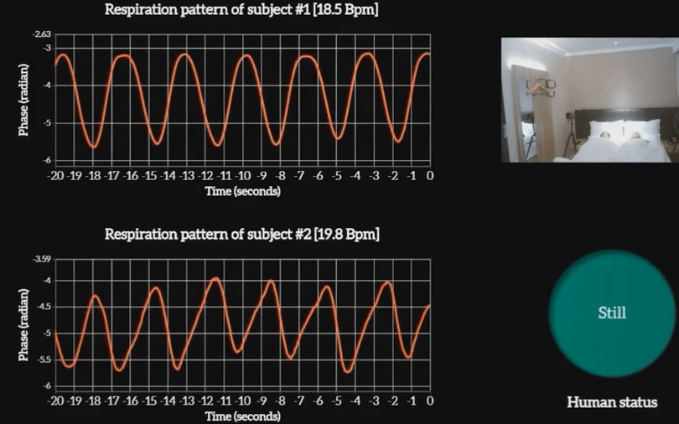
Wang X, Yu A, Niu K, et al. Understanding the Diffraction Model in Static Multipath-Rich Environments for WiFi Sensing System Design[J]. IEEE Transactions on Mobile Computing, 2024.
Notes:
There are 3 main methods to monitor the human respiration . The first one is extract the CSI from the

Slide 5
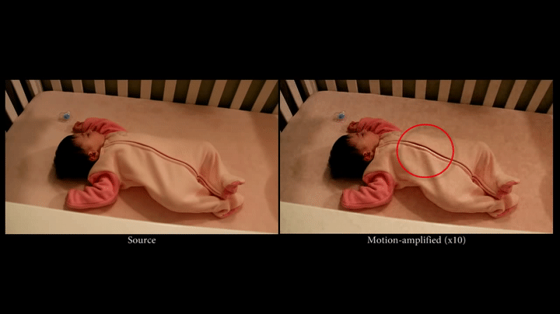
Wu H Y, Rubinstein M, Shih E, et al. Eulerian video magnification for revealing subtle changes in the world[J]. ACM transactions on graphics (TOG), 2012, 31(4): 1-8.
Notes:
Computer Vision

Slide 6
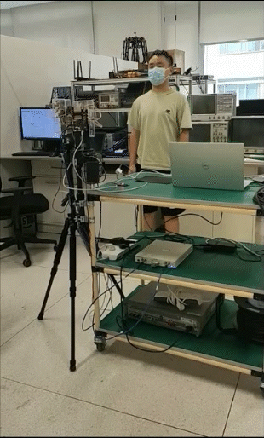
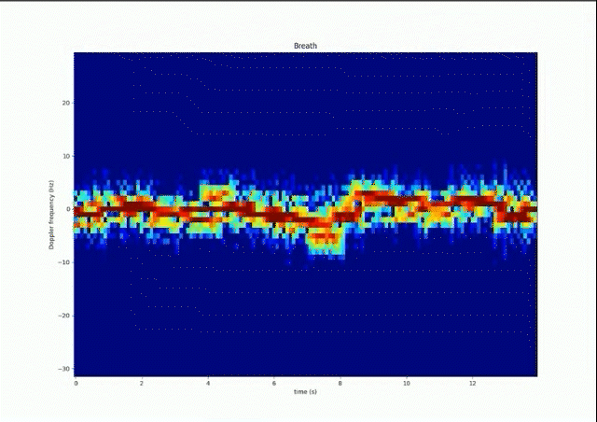
Notes:
We propose the method based on doppler frequency extract from the am function

Slide 7
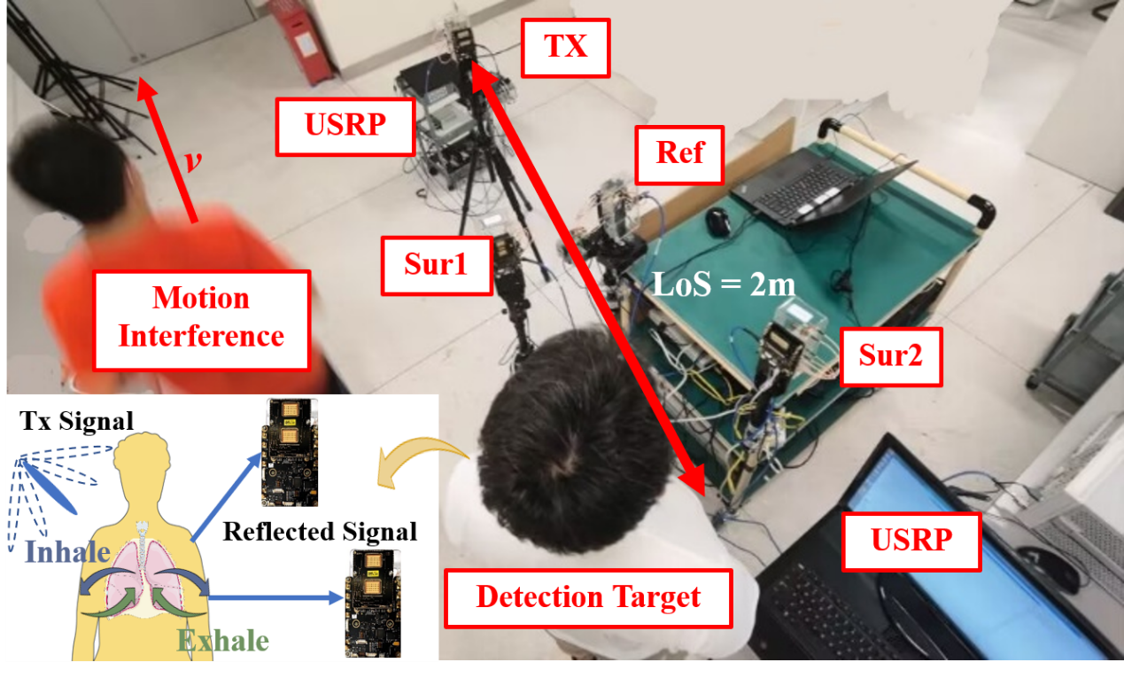
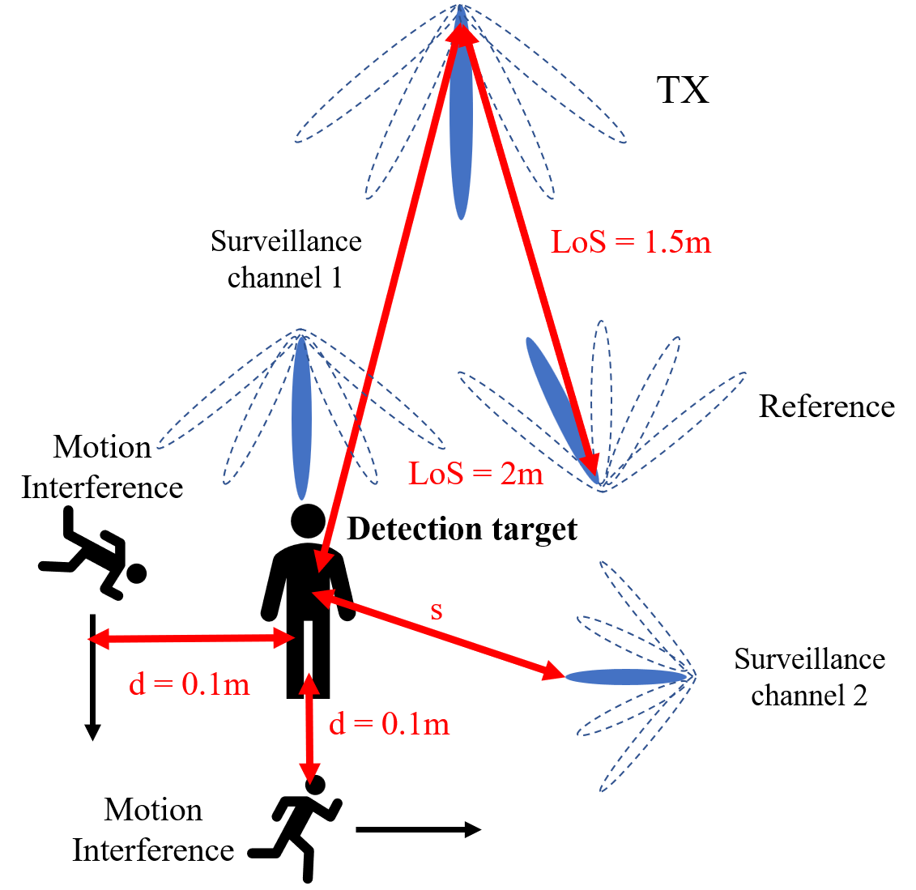
02.Preliminary
Respiration monitoring through mmWave communication signal
Model of the Sensing System
Lay out of the Sensing System

Slide 8
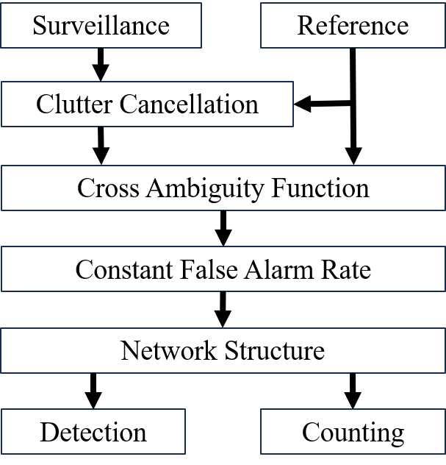
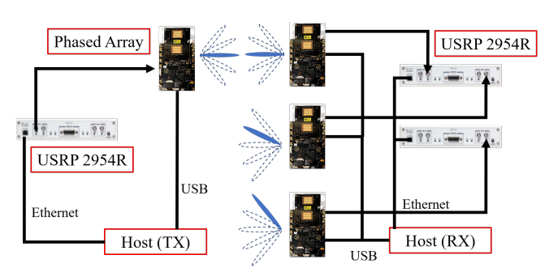
02.Preliminary
Passive mmWave Sensing System
Fig. Human Respiration Detection system

Slide 9
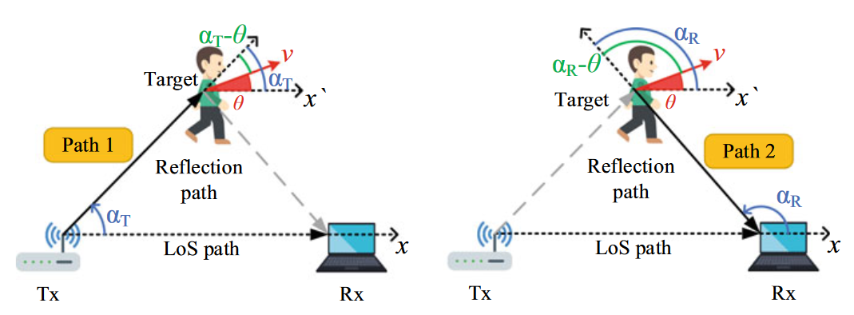
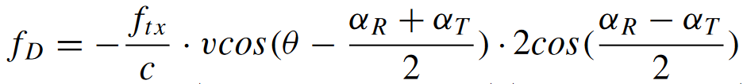
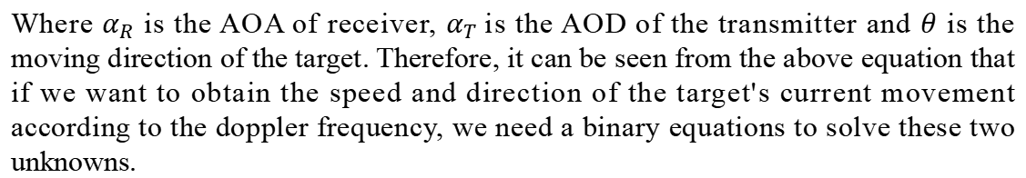
03.Theoretical Basis
Doppler-Velocity Model
Doppler frequency
Where $α_{R}$ is the AOA of receiver, $α_{T}$is the AOD of the transmitter and $θ$ is the moving direction of the target. Therefore, it can be seen from the above equation that if we want to obtain the speed and direction of the target's current movement according to the doppler frequency, we need a binary equations to solve these two unknowns.
Niu K, Wang X, Zhang F, et al. Rethinking Doppler effect for accurate velocity estimation with commodity WiFi devices[J]. IEEE Journal on Selected Areas in Communications, 2022, 40(7): 2164-2178.

Slide 10
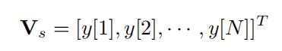
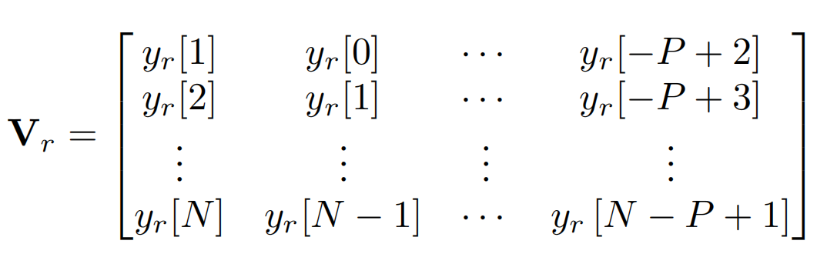
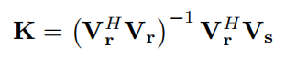
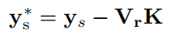
03.Theoretical Basis
The least-square-based (LS-based) clutter cancellation
Motivation: The signal components with zero Doppler frequency in surveillance channel (e.g. Strong LOS component) might interfere the estimation of target doppler frequency. Therefore, the LS-based clutter cancellation is applied for suppressing the above interference.
V_{r} is the matrix of delayed reference signal of the reference channel
V_{s} is the matrix of the surveillance channel
Fit the delay coefficient by the least square method
Surveillance channel signal after LS-based clutter cancellation
D. K. Tan, H. Sun, Y. Lu, M. Lesturgie, and H. L. Chan, “Passive radar using global system for mobile communication signal: theory, implementation and measurements,” IEE Proceedings-Radar, Sonar and Navigation, vol. 152, no. 3, pp. 116–123, 2005.

Slide 11
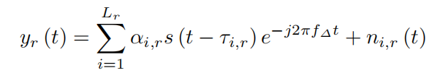
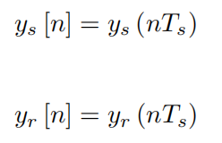
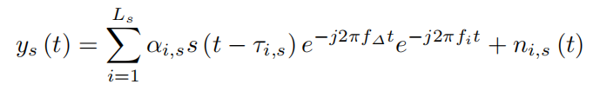
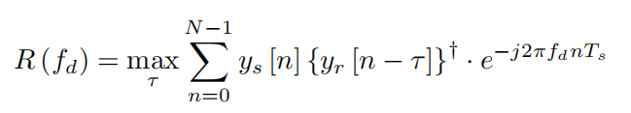
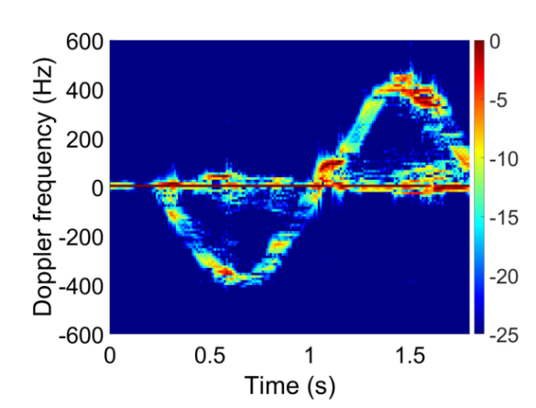
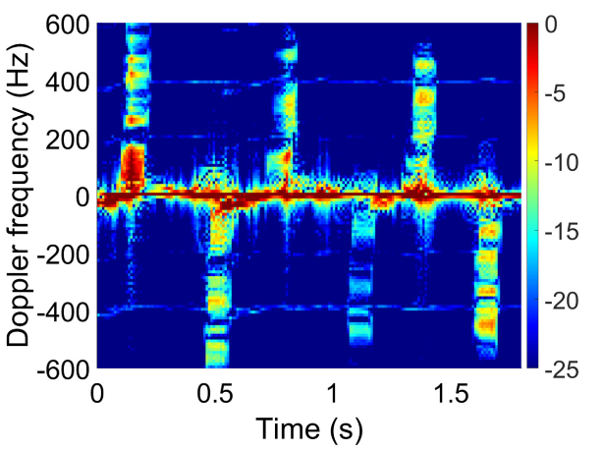
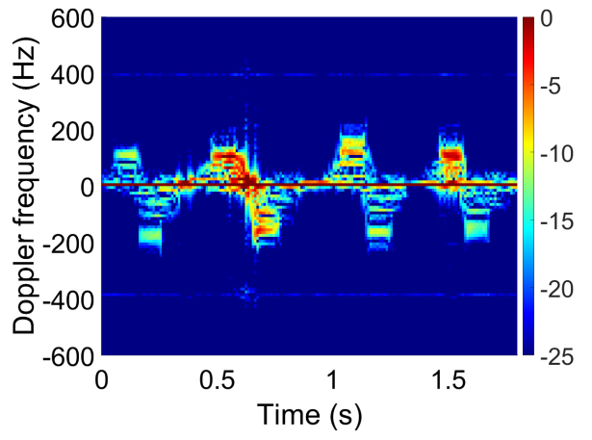
03.Theoretical Basis
CAF (Cross-Ambiguity Function)
Sample
Fig. Different Gesture Spectrograms obtained: pushing hand, beckoned and rubbing finger

Slide 12
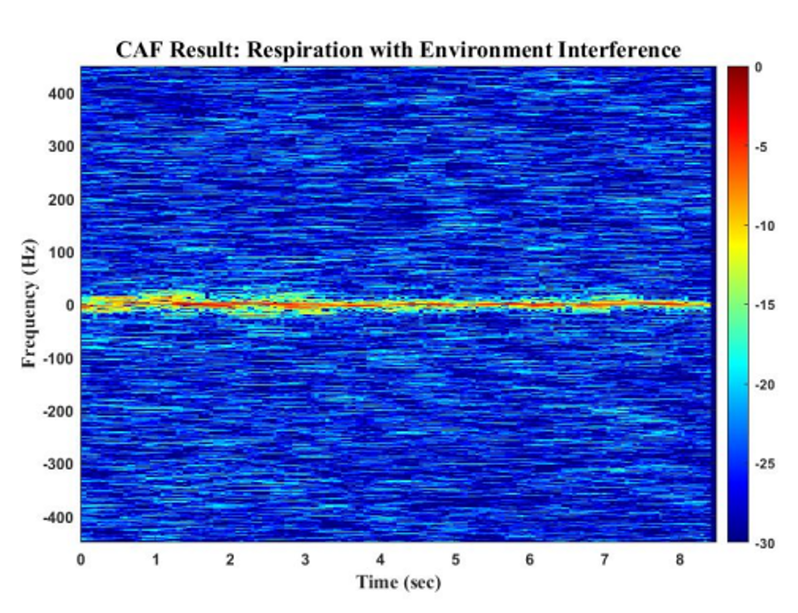
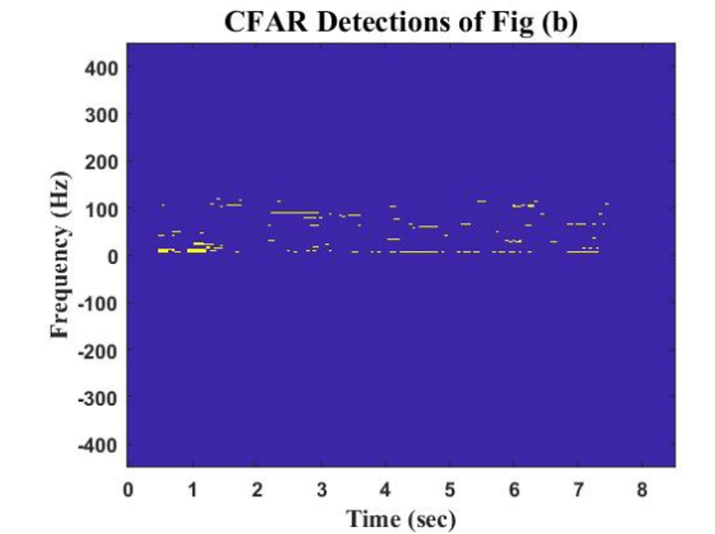
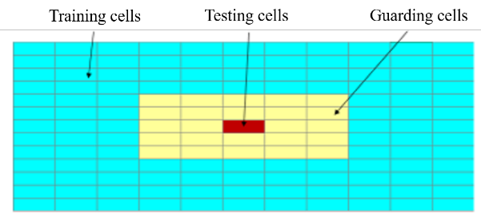
03.Theoretical Basis
CFAR(Constant False Alarm Rate)

Slide 13
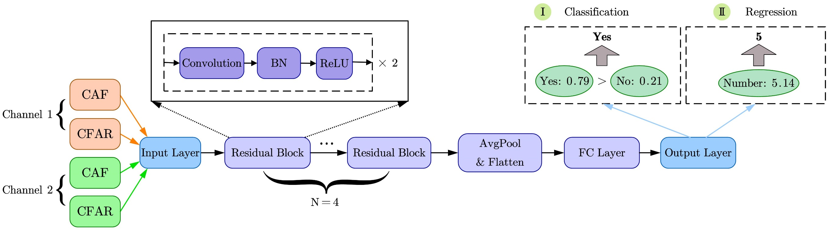
03.Theoretical Basis
Network Structure

Slide 14
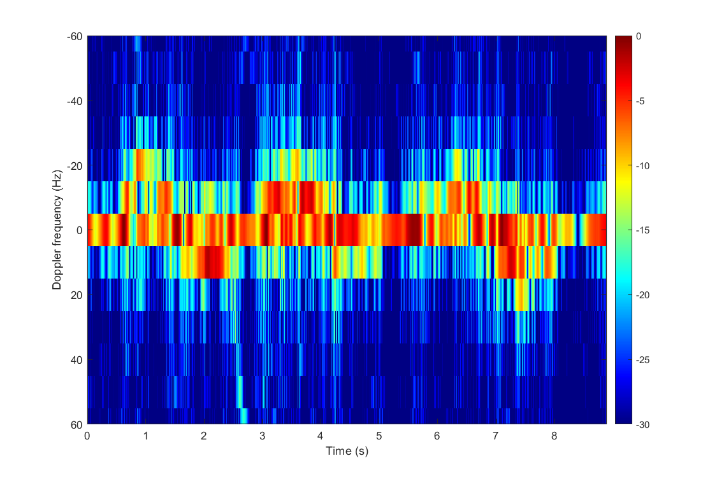
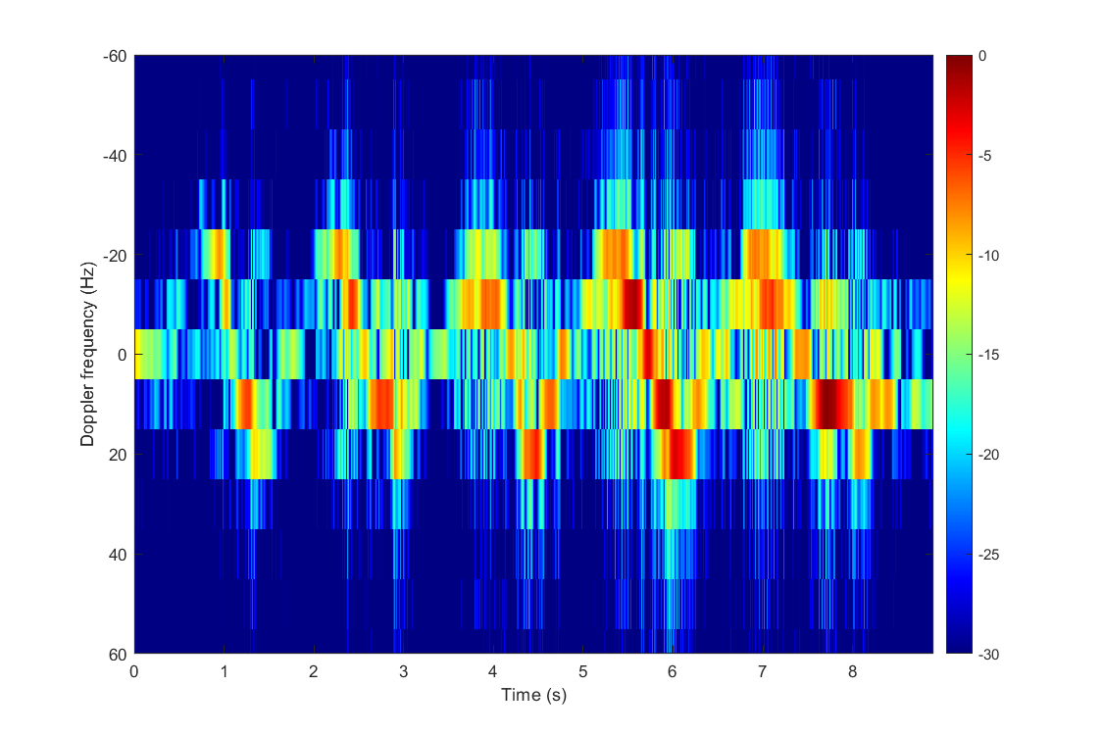
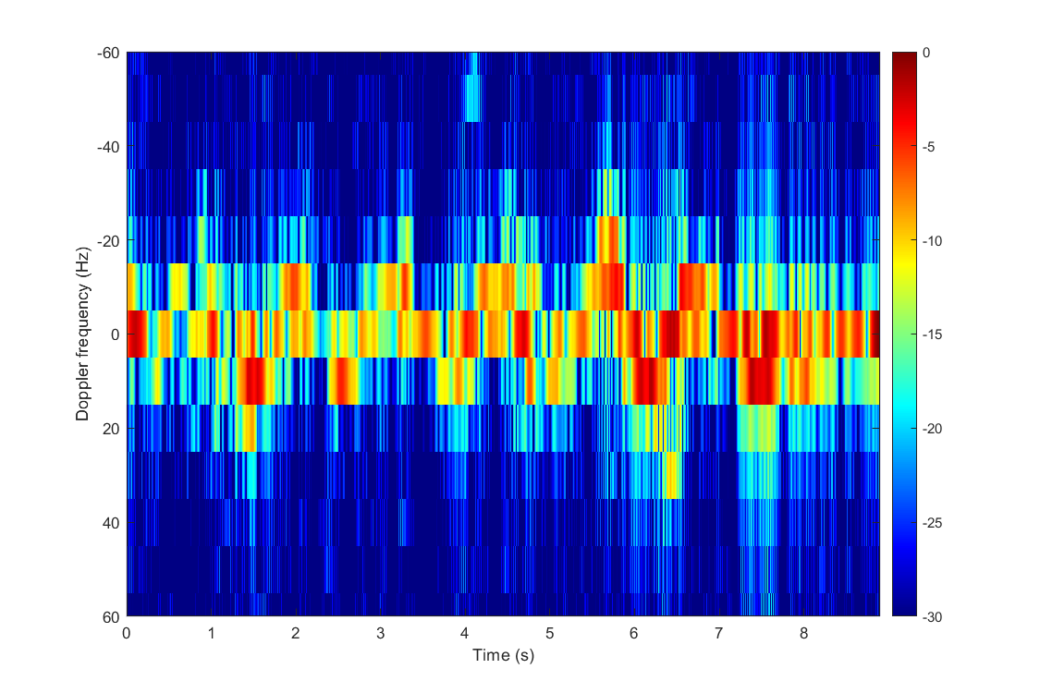
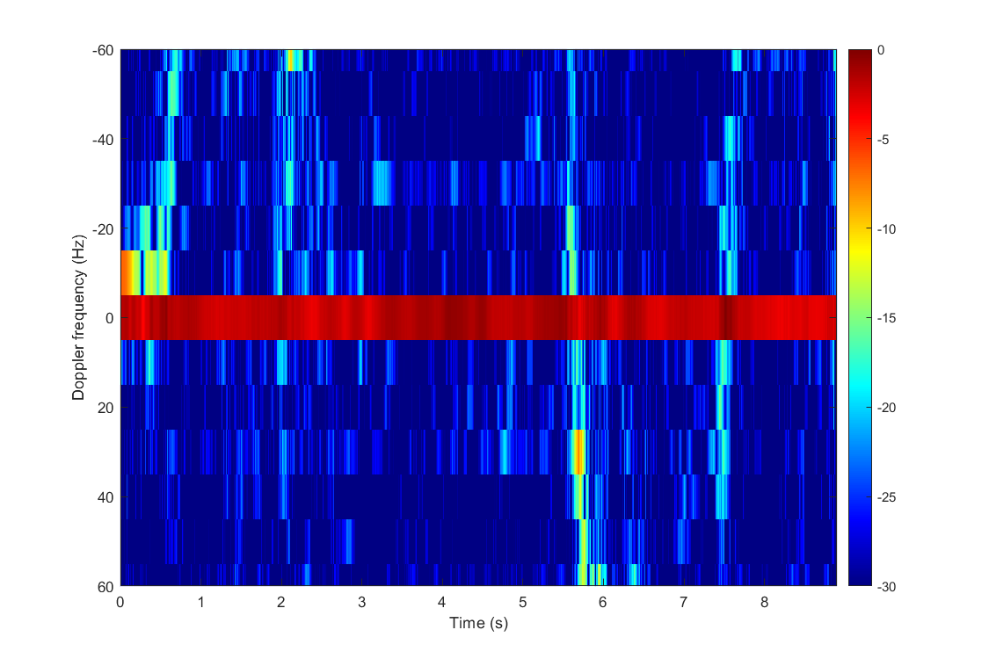
04.Results
3 breath in 8s
5 breath in 8s
6 breath in 8s
0 breath in 8s
Notes:
3 breath in 8s

Slide 15
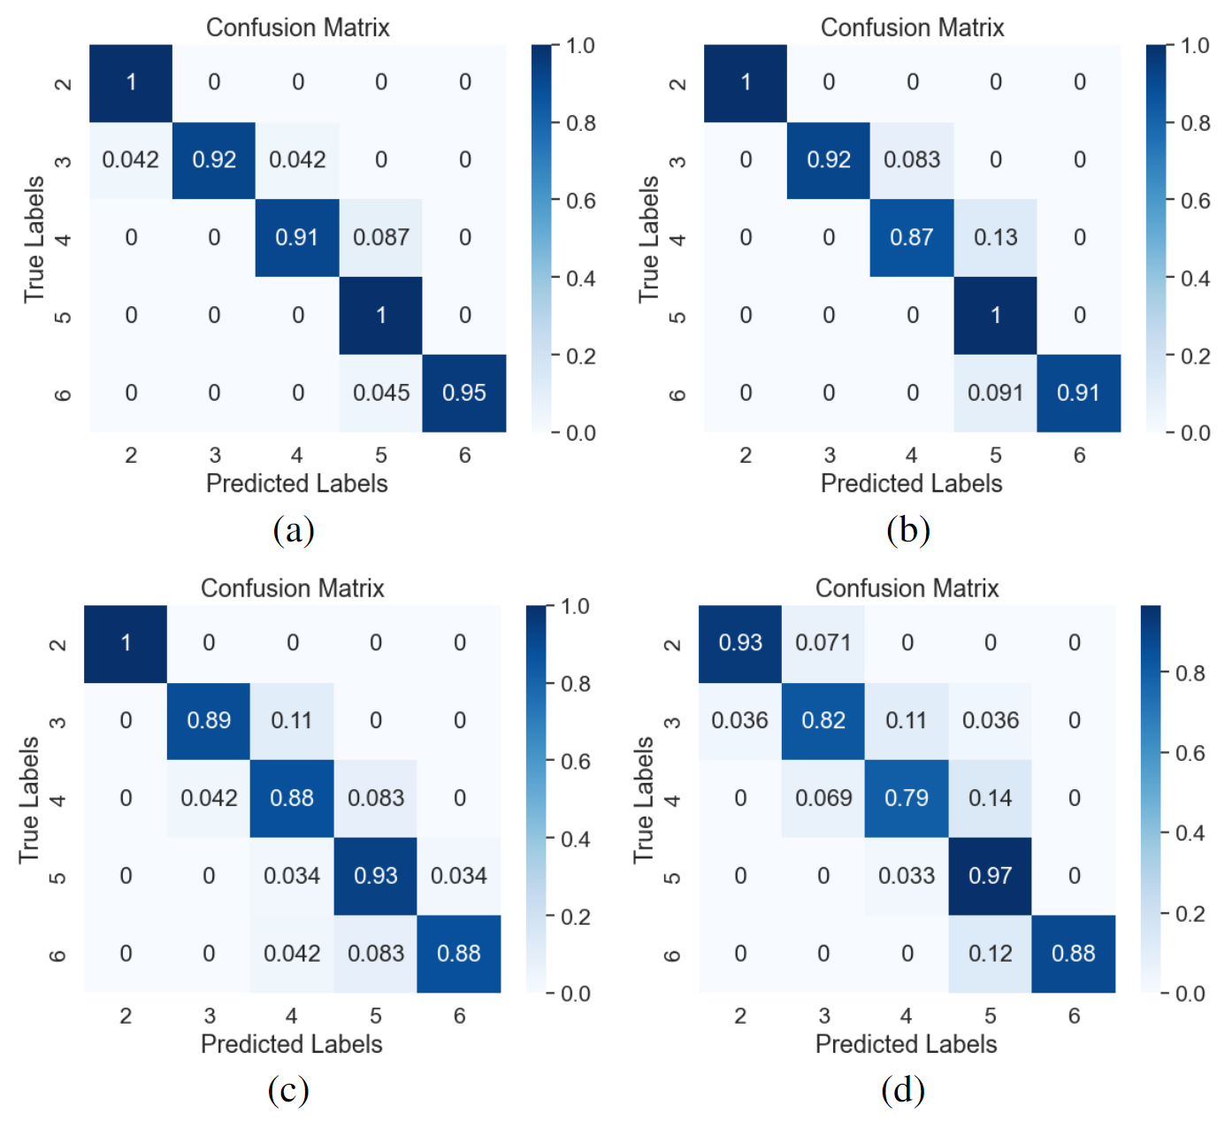
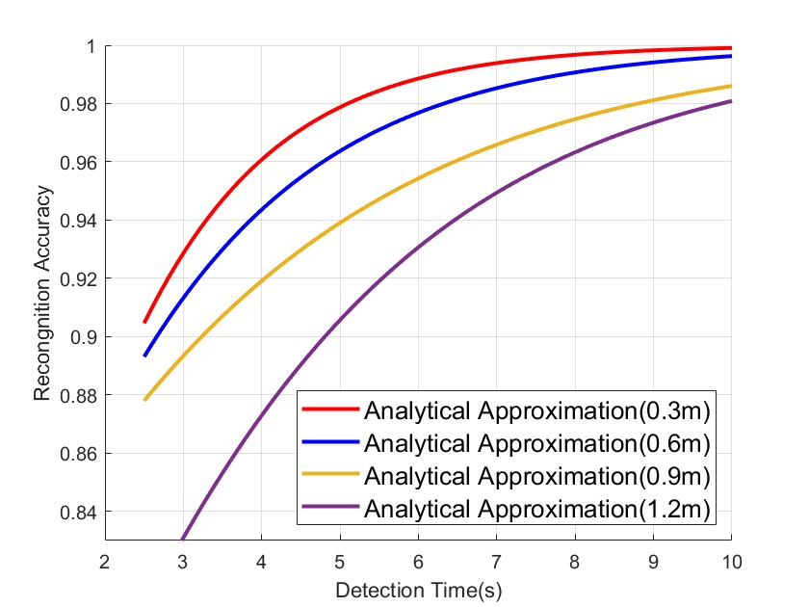
04.Results
Detection
Counting

Slide 16

Thanks for watching！
Notes:
请各位专家老师批评指正！

Slide 17
Q&A

